Slide 1
Why do We pay Taxes?
Go to Google Classroom and complete the Why we pay Taxes Assignment

Slide 2

Required Work Forms
Form W-4: Employee’s Withholding Allowance Certificate
Social Security forms
I-9 Forms
Form W-2: Wage and Tax Statement

Slide 3
Form W-4: Employee’s Withholding
W-4 form: the IRS document you complete for your employer to determine how much should be withheld from your paycheck for federal income taxes and sent to the IRS
tells the employer the amount of tax to withhold from an employee's paycheck based on their marital status, number of dependents, and other factors.

Slide 4

Key Facts: Employee’s Withholding
Determines the amount of money for taxes withheld (taken out)
Completed the first day on the job/career
Does not determine what you owe in taxes, only what is paid from each pay check:
The more you earn the more you owe in taxes, the more withheld from your check
When you don’t withhold enough = you owe taxes at end of year
When you pay to much in taxes, you will get a refund
Can be changed at any time due to significant life events
getting a new job, getting married, or having children

Slide 5
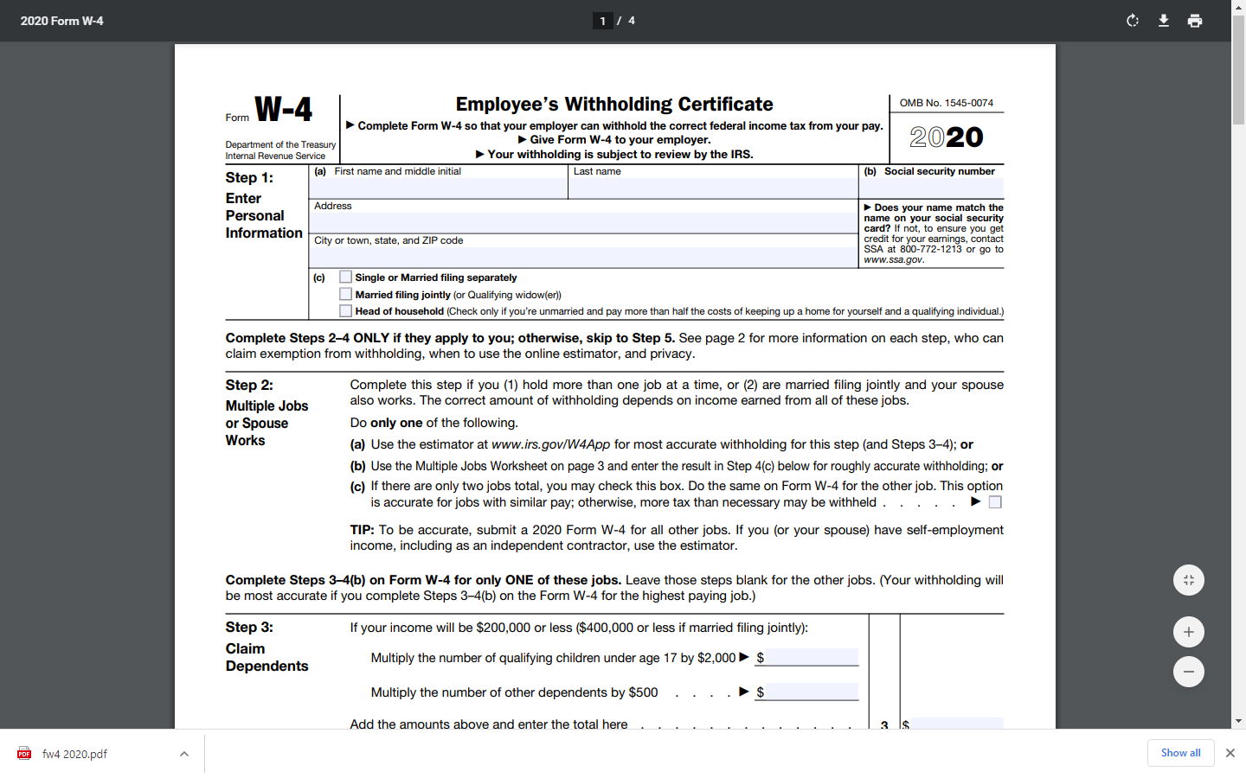
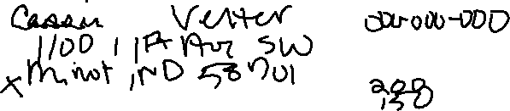
Work Together
Complete a W4 together
1 Complete together and hand in to your instructor

Slide 6
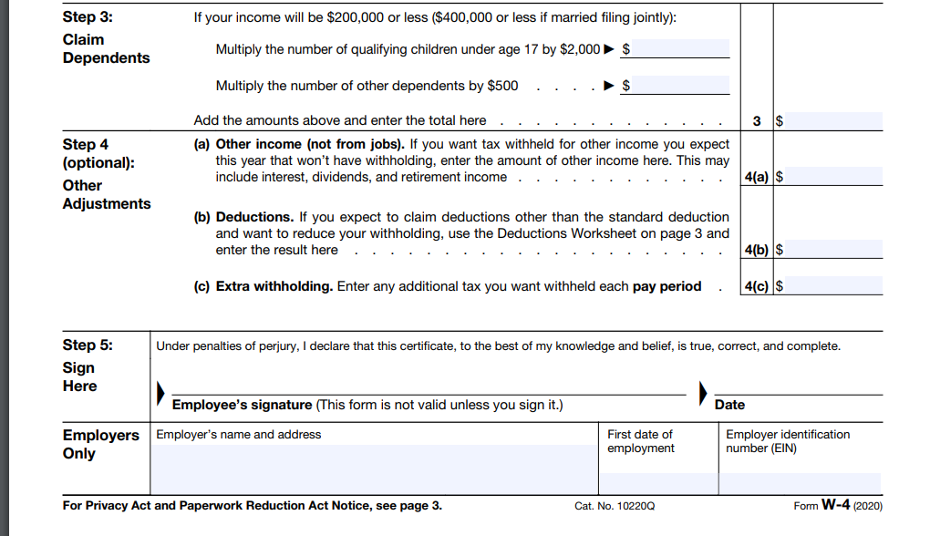
Dependents: an individual who are under the age of 19, are disabled, or a student under age 24 that have lived with the taxpayer for more than half the year and not have earned more than half of their financial support

Slide 7
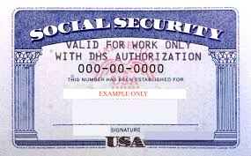
Social Security forms
Social Security Card: Your permanent work identification number that all US citizens must have
Main Purpose: Used to track your earning history for Social Security benefits
Also used for:
Card needed to gain employment
Required to receive a credit card
Required to receive a Driver’s license and other personal documents

Slide 8
Social Security Card
Card Security:
Do not give your SS# to anyone on the phone , mail, email, or internet services
Keep in a safe place at home – not in wallet
If Lost or Stolen:
Get a new one for free from any Social Security Office
3 copies in one year, 10 copies in your lifetime
Two Ways to get a free card:
Online Application
Visit a local Social Security office.

Slide 9
Assignment
Get out your computer. We will step through this but not complete it
Google the term Social Security card
Find the link to get a replacement card. Make sure you are on a trusted site for the Social Security Administration
Select Answer a Few Questions
.

Slide 10
Social Security Card
If Lost or Stolen:
If 18 or older:
Can get an application on-line for a SS# - must mail it in along with proof of age and identity:
Proof of age = birth certificate
Proof of Identity = A govt. issued photo ID, driver’s license, or Passport
Items of proof must be mailed, not scanned or copied. They will be returned to you within 5 -10 business days.
If Under 18 you must go to an office with your parent to get one.

